Slide 1
Day 2: The Carbonate System and its observation
What happens when CO₂ enters sea water?
CO2 equilibrium system
How to derive the carbonate system
pCO₂, DIC, Talk, pH
How to observe each of these 4 master variables
Stoichiometry plots
Revelle (Buffer) factor
Practical: Deriving the carbonate system: Bjerrum and stoichiometry plots

Slide 2
What happens when CO₂ enters the ocean?
CO₂ → CO2aq → H2CO3* →HCO₃⁻ → CO₃²⁻
Hybridization of electron shells is what makes this possible and helps understand the relatively slow kinetics of the carbonate equilibrium
[explain on the board]

Slide 3
CO₂ equilibrium system - 1
Carbonate is a weak acid system – that it is not completely dissociated
CO₂ + H₂O ⬄ H₂CO₃* ⬄ HCO₃⁻ + H⁺ ⬄ CO₃²⁻ + H⁺
H₂CO₃* ⬄ HCO₃⁻ + H⁺ ⬄ CO₃²⁻ + H⁺
K₁
K₂

Slide 4
Carbonate Equilibrium Plot (Bjerrum Plot)
Monteiro, 1996

Slide 5
How to derive the carbonate system
10 unknowns: CO_{2(g)}; H₂CO₃*; HCO₃; CO₃²⁻; DIC; TA; [H⁺]; OH⁻; B(OH)₄⁻; B(OH)₃;
5 Eq constants K₀; K₁*; K₂*; K_{w}; K_{B};
3 Mass balance equations (DIC; TA; B_{T})
2 observed variables are necessary
pH, DIC, TA, pCO₂ can be observed accurately
[CO₃²⁻] = DIC/(1+[H⁺]/K₂* +[H⁺]²/K₁*K₂*)

Slide 6
CO₂ equilibrium system – 2
K₁* = [HCO₃⁻][H⁺]/[H₂CO₃*]
K₂* = [CO₃²⁻][H⁺]/[HCO₃⁻]
K_{w} = [H⁺][OH⁻]
K_{B} = [B(OH)⁻₄][H⁺]/[B(OH)₃]
DIC = ….
TA = …..
B_{T} = ….

Slide 7
Effect of Temperature, Salinity and Pressure: what happens?
Ki* = f (T, S,p)
DIC & TA – conservative independent of T,S
What are the implications for observations of water samples vs in situ carbon floats and gliders?

Slide 9
Master variables: DIC
Mass balance parameter
DIC = [H₂CO₃*] + [HCO₃⁻] + CO₃²⁻]
Conservative variable (not dependent on t, S, P)
Molal scale – μmolkg⁻¹
Observable – very accurately

Slide 10
Master variables: Total Alkalinity
Capacity parameter: proton or charge balance
μmolkg-1
TA = [HCO3-]+2[CO32-]+[B(OH)4-]+[OH-] … - [H+]-[HSO4-]-[HF]-….
TA = [HCO3-]+2[CO32-]+[B(OH)4-]+[OH-] – [H+]
TA = Σ conservative cations - Σ conservative anions

Slide 11
pH scales
Very NB: consistency with the equilibrium constants – large errors possible
pH = -log[a⁺] - NBS (infinite dilution)
Total Scale
-log[H⁺]_{T} = pH_{T} = -{log[H⁺]_{F} + log[HSO₄⁻]}
SW Scale
-log[H⁺]_{SWS} = pH_{SWS} = -{log(H⁺]_{F} + HF}

Slide 12
Master variables: pCO2
Cover pCO2 in Day 4

Slide 13
How do these variables relate to eachother?
Stoichiometry (Deffeys) plots

Slide 14
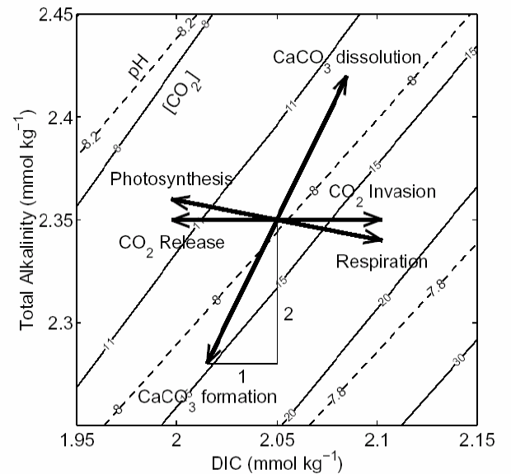
Deffeys Plot
Wolf-Gladrow, 2007

Slide 15
Revelle (Buffer) factor 1
What happens when you add CO₂ to ocean water?
CO₂ + H₂O + CO₃²⁻ → 2HCO₃⁻
This is how the sea water buffer works – but is comes at a price – consumption of CO₃²⁻

Slide 16
Revelle (Buffer) factor 2
What is the Revelle factor
RF = d[CO₂]/[CO₂]/d[DIC]/DIC _{(fixed TA)}
Ratio of the relative change in pCO2 to the relative change in DIC

Slide 17
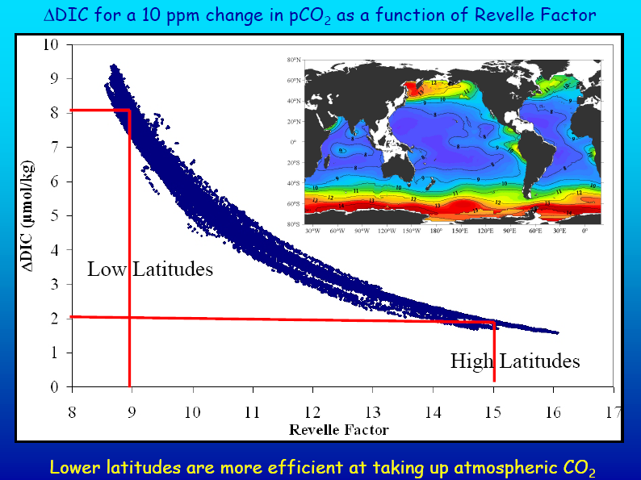
NOAA, 2008

